Slide 1

robotics workshop day 2

Slide 2
Project 2 Obstacle Avoider

Slide 3
Obstacle Avoider
How does it work

Slide 4
Requirements
Arduino
USB connector
Computer
Ultra sonic sensor
Motors - 2
Wheels -2
Caster ball – 1
Switching circuit
Batteries(9v) – 3
Battery connectors – 3
Screws
Tape

Slide 5
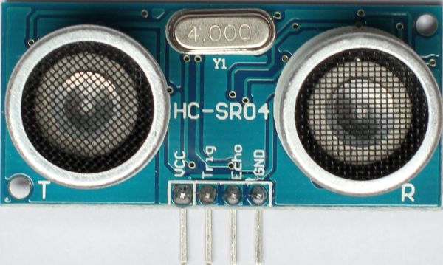
About the parts
Ultra sonic sensor

Slide 6
Rules,warnings
Do exactly as instructed
Some parts are very fragile and may get damaged if used improperly
Students will have the replace the parts damaged
After the project is over dis-assemble your project very carefully

Slide 7
Steps for the project
Take out the parts you need

Slide 8
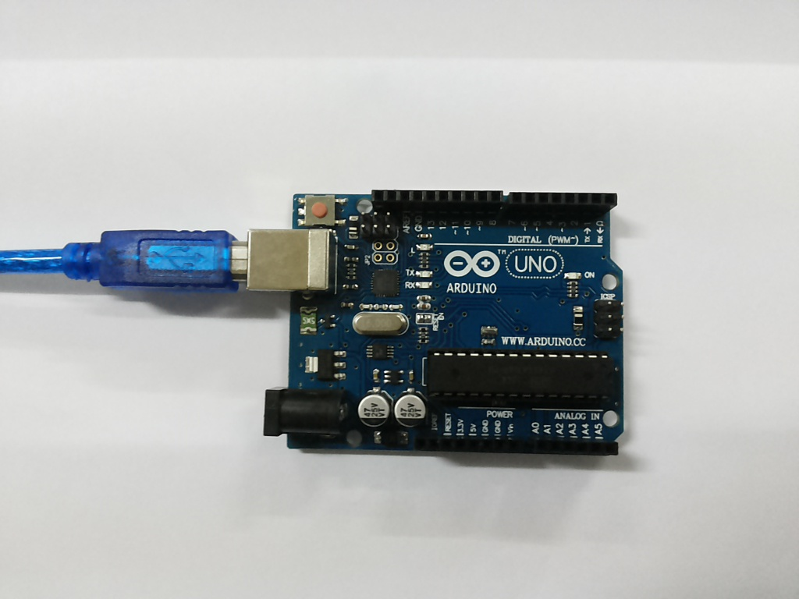
Steps for the project
Connect your arduino to system

Slide 9
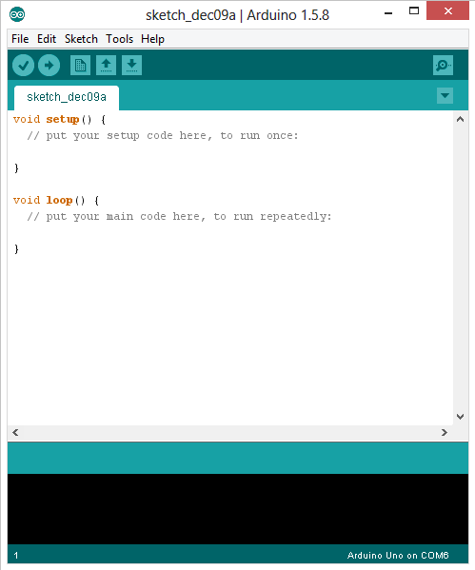
Steps for the project
Upload the sketch to the arduino

Slide 10
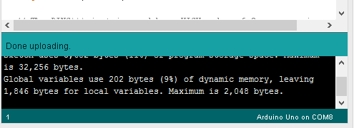
Steps for the project
Disconnect it after the done uploading is displayed

Slide 11
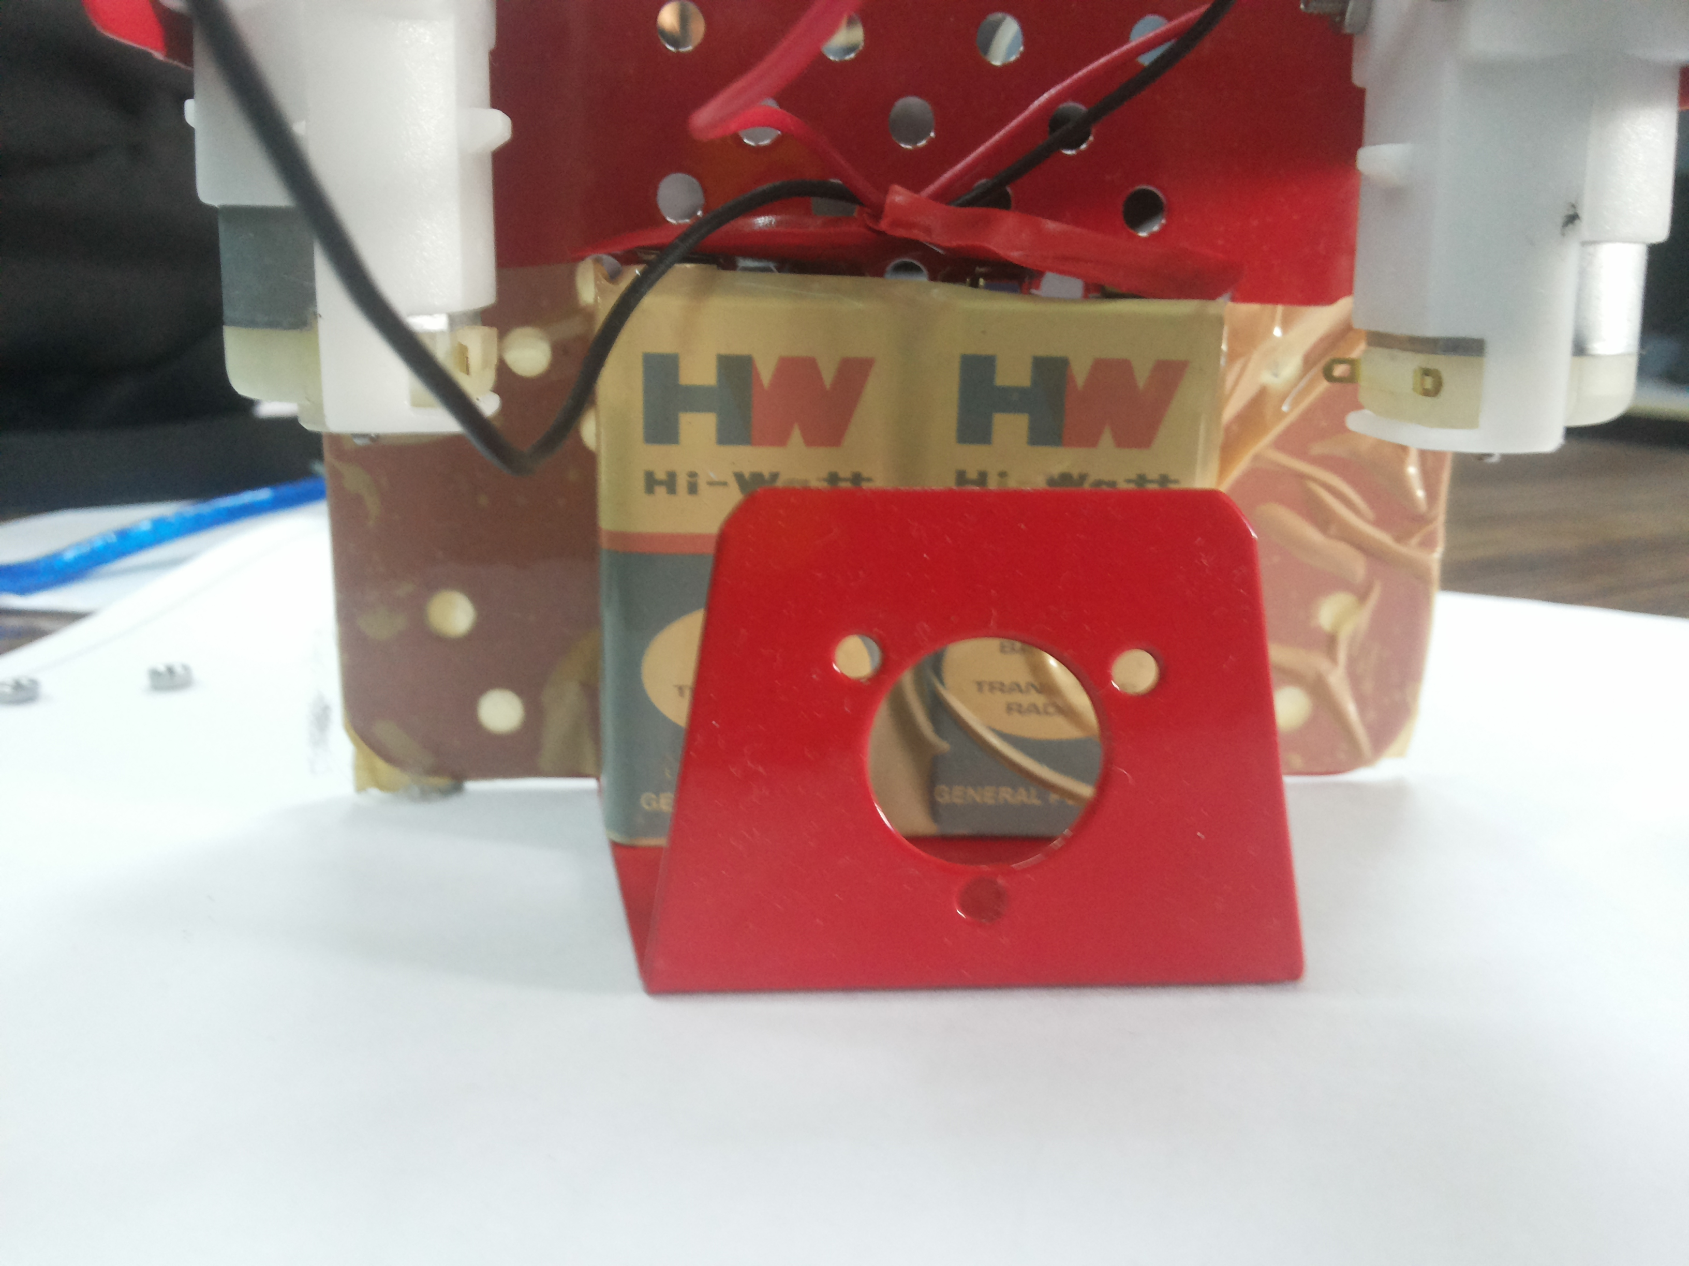
Steps for the project
Tape the batteries to the chassis

Slide 12
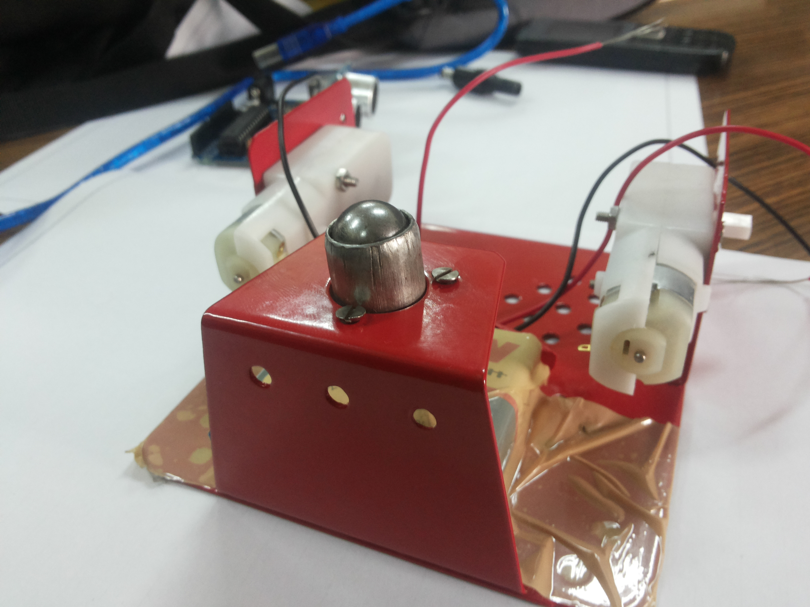
Steps for the project
Mount the caster ball

Slide 13
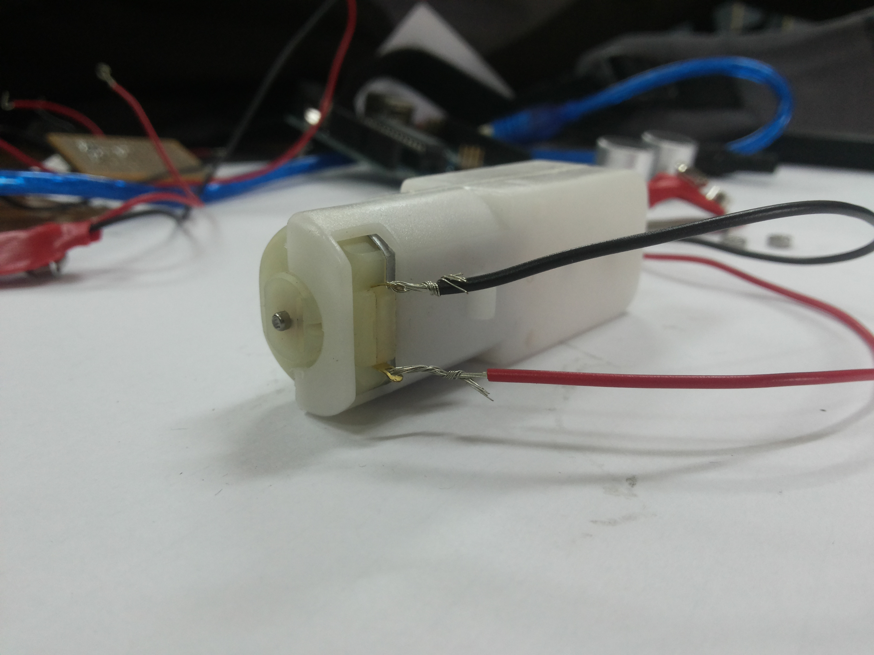
Steps for the project
Connect battery connector to left motor

Slide 14
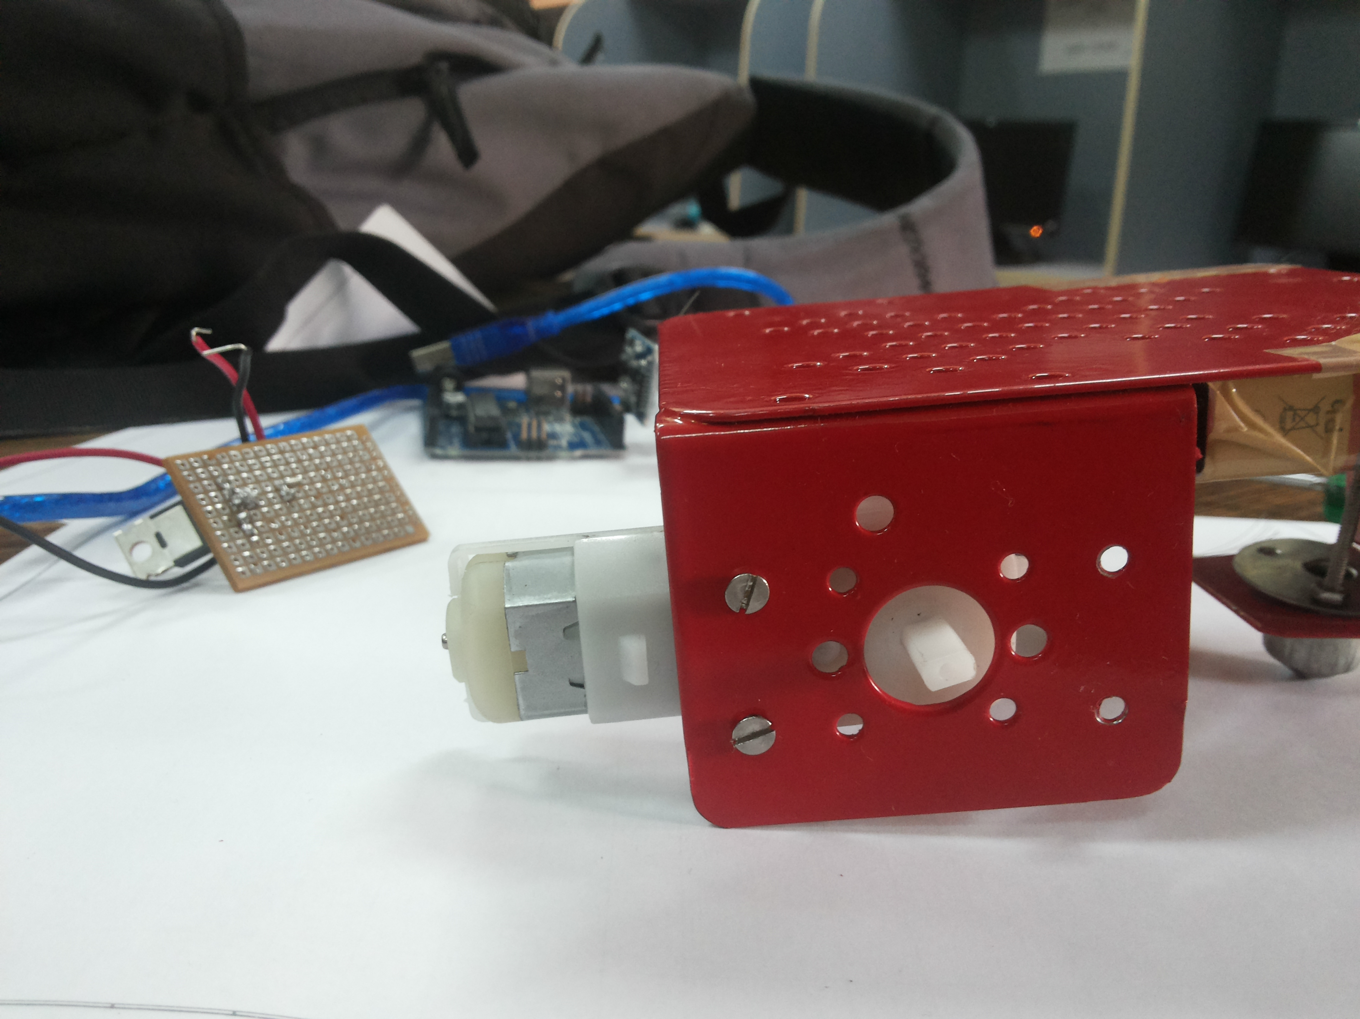
Steps for the project
Mount left and right motor on chassis

Slide 15
Steps for the project
Take out the switching circuit

Slide 16
Steps for the project
Connect positive of battery to motor

Slide 17
Steps for the project
Connect -ve pin of battery to source

Slide 18
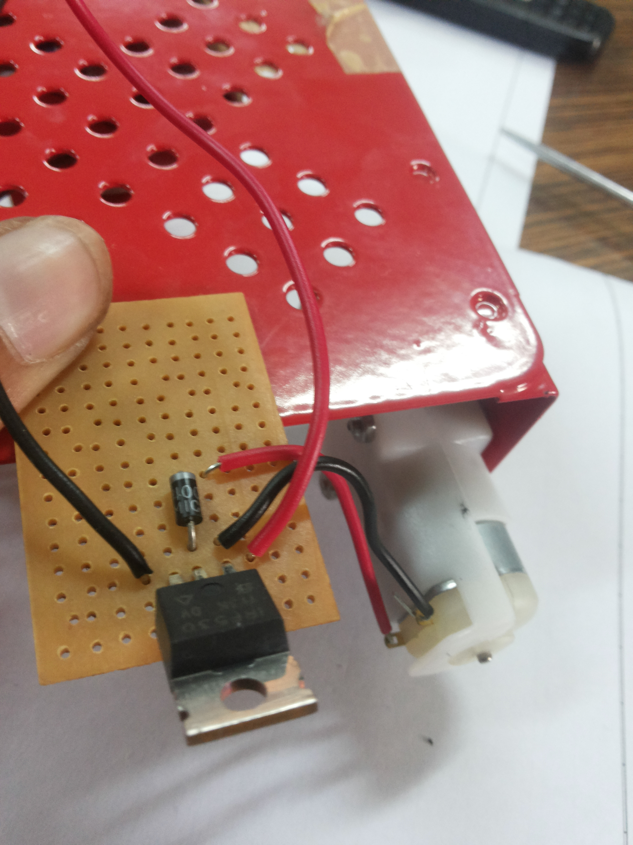
Steps for the project
Connect switching circuit in parallel to motor

Slide 19
Steps for the project
Tape the switching circuit on
to chassis

Slide 20
Steps for the project
Mount arduino on chassis

Slide 21
Steps for the project
Connect the gate to the 7th pin of arduino

Slide 22
Steps for the project
Connect source to the ground

Slide 23
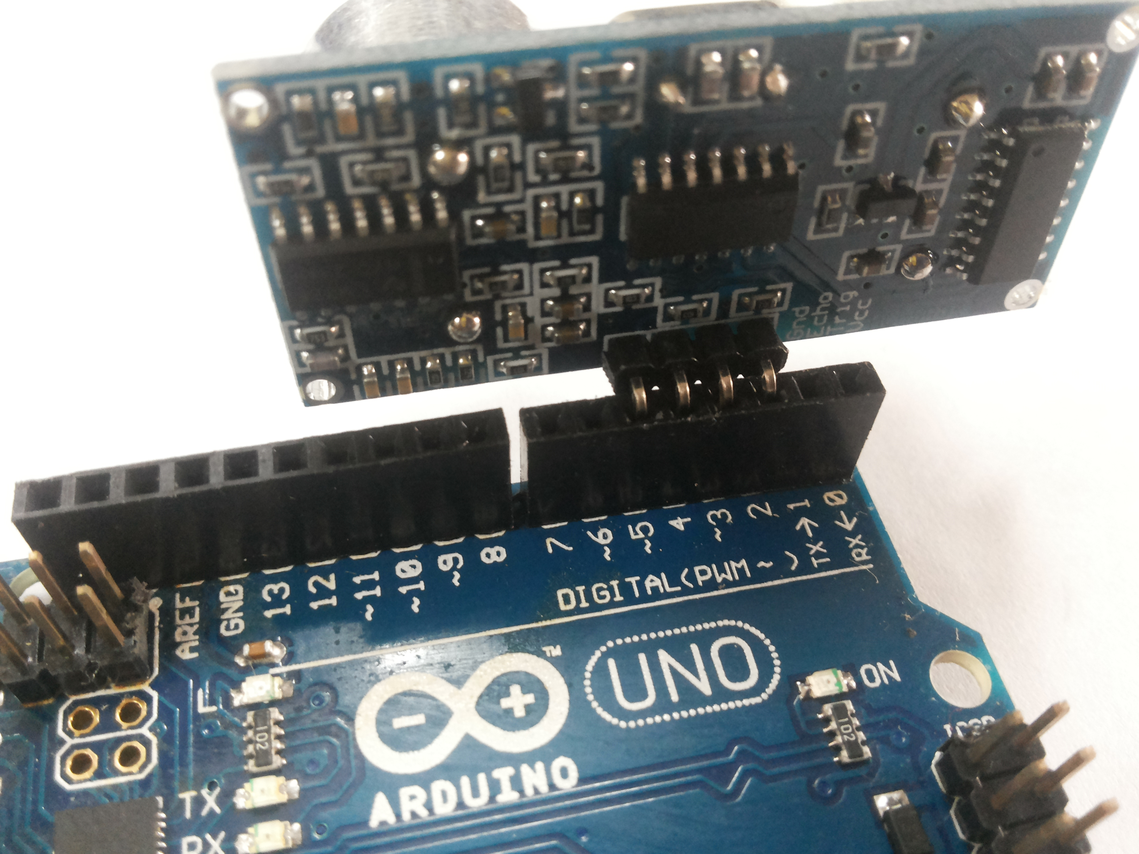
Steps for the project
Connect distance sensor to arduino

Slide 24
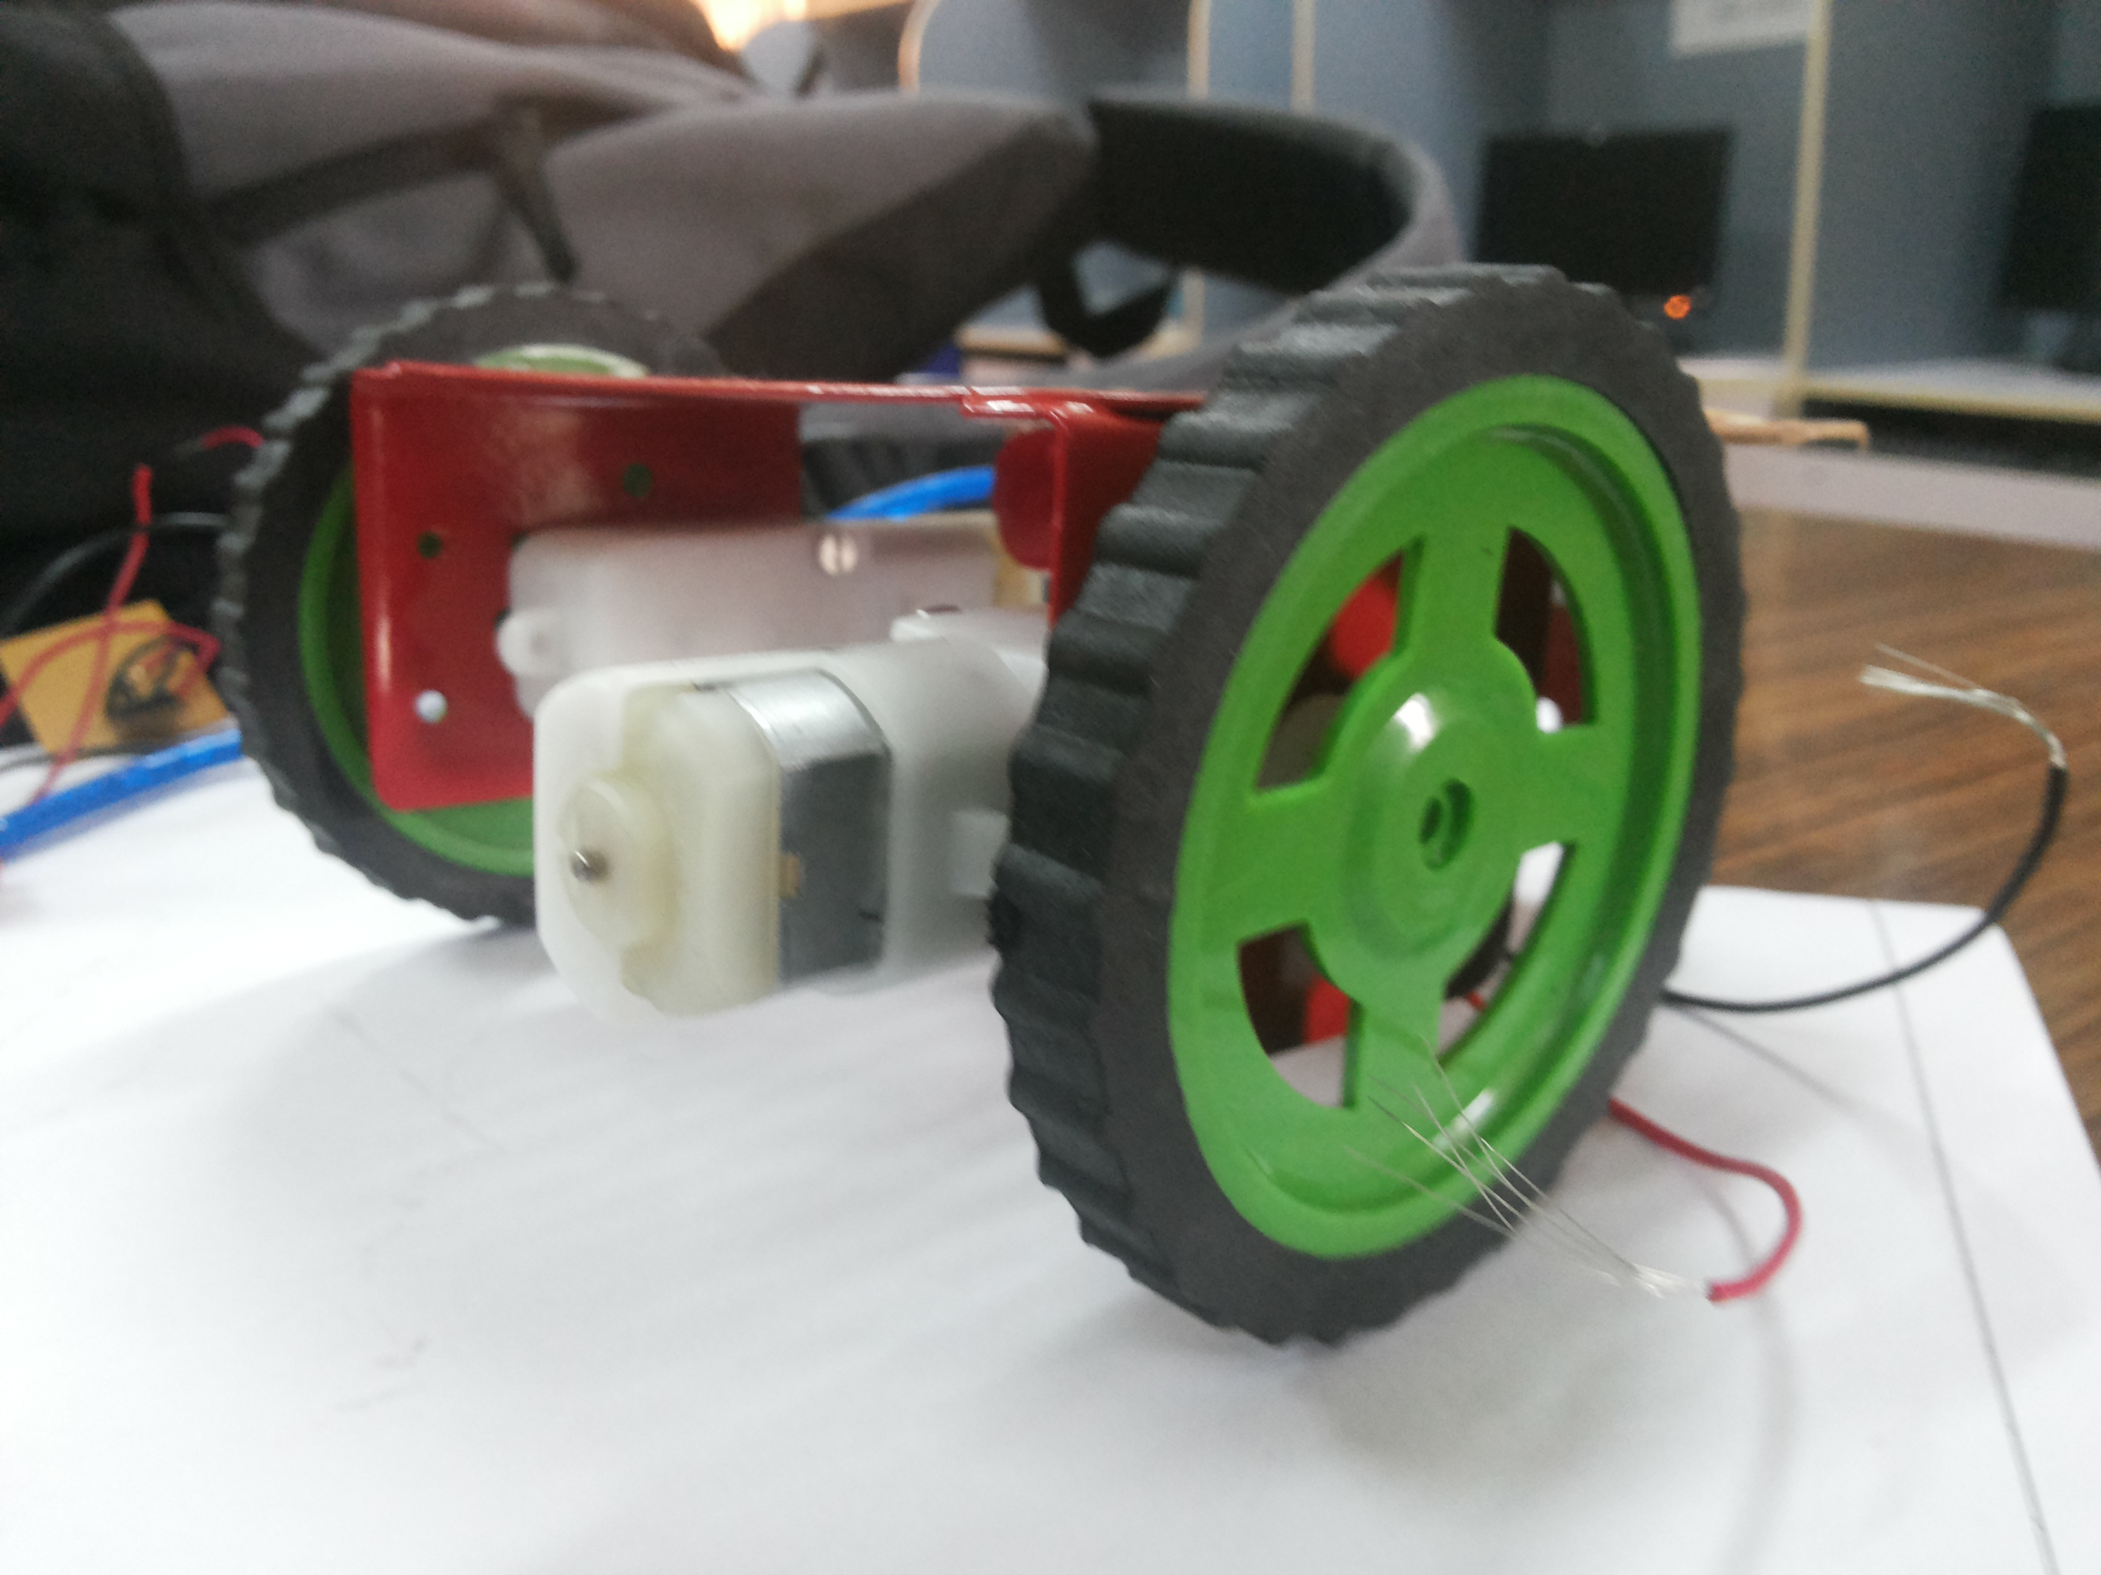
Steps for the project
Attach wheels to the motor

Slide 25
Steps for the project
Power on your arduino

Slide 26
Steps for the project
Connect the battery connectors

Slide 27
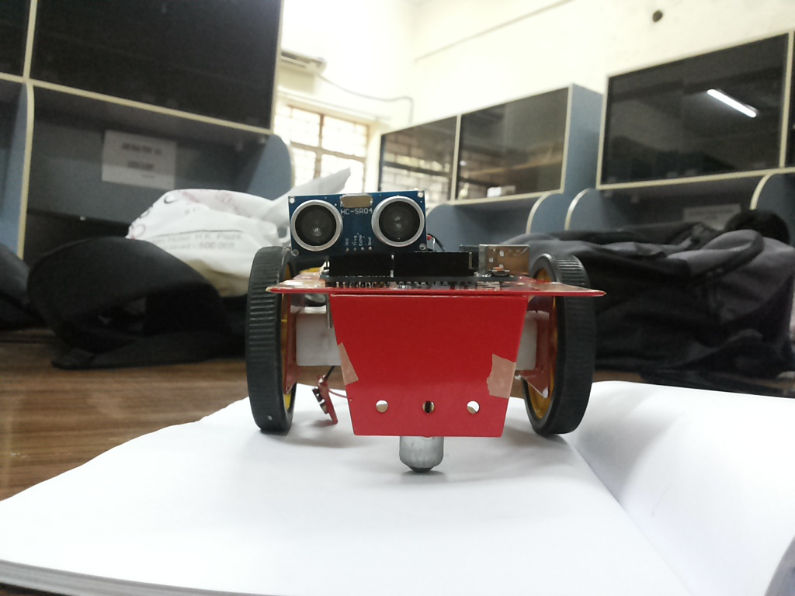
Steps for the project
Let your robot roll

